Slide 1
Annual Sales
Data Analysis Report for 2024
Prepared by: Godswill Enaohwo
June 2025

Slide 2
Report Summary
•2020 saw significant sales growth, with a 13% increase in revenue compared to the previous year
•Q2 and Q4 were quite outstanding quarters

Slide 3
Total Sales Overview
Total Revenue: $194.8K
Year-over-Year Growth: +13%
Total Units Sold: 54083 units
Top Performing Quarter: Q4 (29% of annual revenue)
Top Performing Month: May

Slide 4
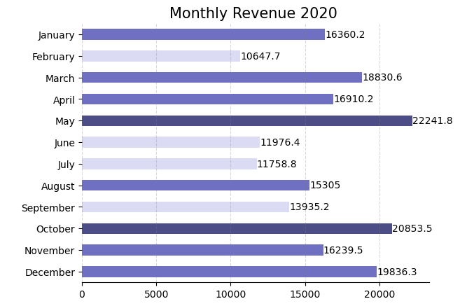
Monthly Sales Revenue
We had exceptional monthly revenue in the months of May and October, crossing the $20k mark on both months, with May being the top performing month for the year

Slide 5
Monthly Sales Revenue
We surpased $10k revenue in all the months. While we were not able to meet the monthly target of $15k in the months of February, June, July and September, we were able to it for 8 months and with exceptional monthly revenue in the months of May and October which surpased $20k respectively.ay being the top performing month for the year
Top Month Revenue
Monthly Average Revenue
$22.2k
$16.2k
48%
7.6%
Total Revenue
$194.8k
13%

Slide 6
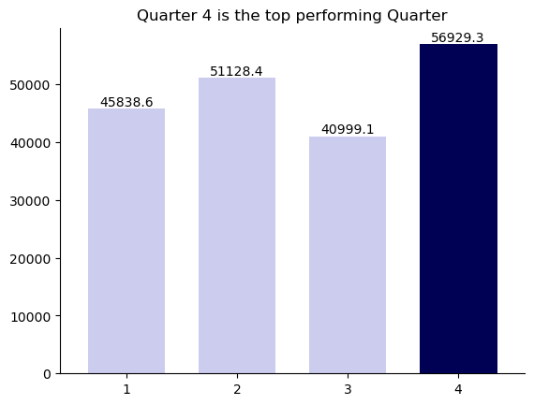
Quarterly Sales
Quarter 4 is the top performing quarter with $56.9k in revenue accounting for 29% of the annual revenue. In quarter 4 we exceed the quarterly revenue target by 26.51%.
Quarterly Revenue Target

Slide 7
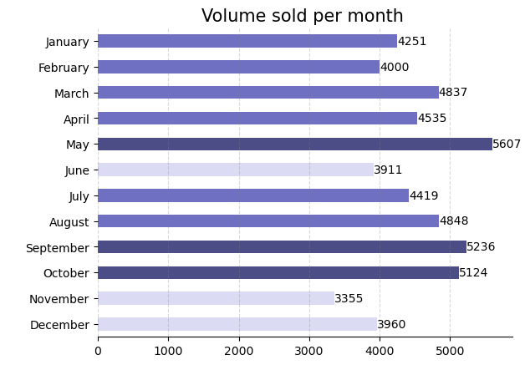
Quantity Sold per month
While we were not able to meet the monthly target of 4000 in the months of June, November and December, we met and surpassed it in 9 of the 12 months and with exceptional volume above 5000 done in the months of May, September and October which surpassed respectively.

Slide 8
Summary of Quantity Sold
Top Month Volume
Monthly Average Volume
5.6k Unit
4.6k Units
40%
0.02%
Quarterly Average
Volume
Total Volume Sold
54k Units
13.5k Units
9%
0.15%

Slide 9
Top 5 Peforming Products
A total of $38127.8 was raked in from these 5 products at an average of $7625 made from each product. This products accounts for 19.5% of the total revenue making them the top 5 performing products
Product Revenue
SKU1129 9690.1 SKU1096 7650.42 SKU1121 7004.28 SKU1072 6999.98 SKU1130 6783.02

Slide 10
Bottom 5 Performing Products
These 5 products performed abysmally raking it a total of $7.79 at an average revenue of $1.55 from each product. This products accounts for 0.004% of the total revenue
Opportunity: Revamp and reposition the low performing products
Product Revenue SKU141 1.74
SKU978 1.7
SKU788 1.68
SKU812 1.68
SKU1052 0.99

Slide 11
Top 5 Customers
From our 630 persons Customer base these 5 comes top accounting for $23288.12 in purchases at an average of $4657.62 per Customer, amounting to 11.94% of the total revenue for the year.
Opportunity: Create a personalized blue chip customer experience for these Customers in other to sustain their patronage
Customer ID Amount
C179 6783.02
C409 5136.25
C171 3973.51
C226 3859.94
C189 3535.40

Slide 12
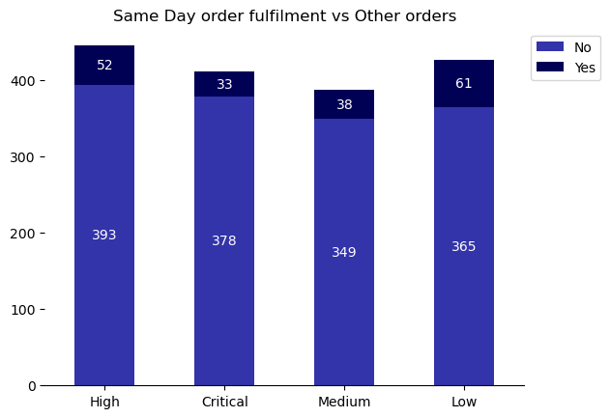
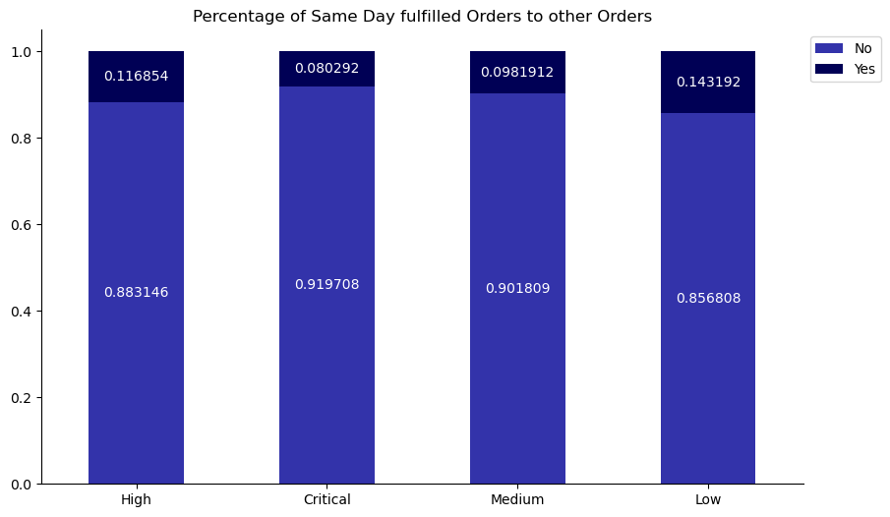
Same Day Order Fulfilments
Same day fulfilled Orders in High and Critical Priority Orders which is 12% and 8% respectively are less than that of Low Priority orders which is 14%.
Opportunity: Sales Officers should be instructed to always prioritize High and Critical Orders over other orders to increase revenue from Express Service fees which is refunded when Same day fulfilment is not achieved

Slide 13
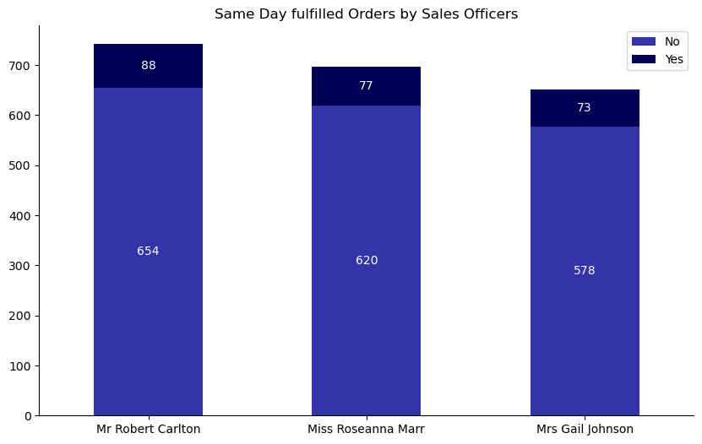
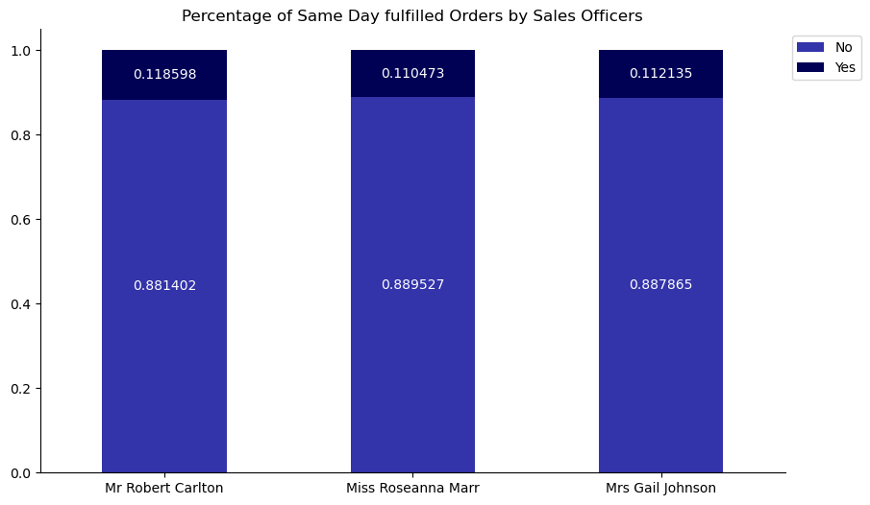
How our Sales Officers Performed
Robert Carlton leads the other sales Officers having fulfilled the most number of Orders of 742 orders and also the most same day fulfilment percentage of 11.85%
Opportunity: Encourage Robert to share best practice with other Sales Officers and also reward him for the achievement.

Slide 14
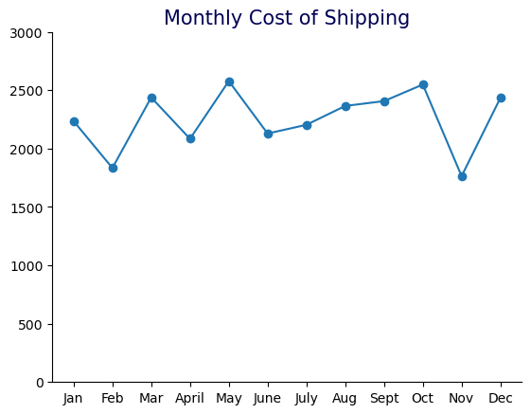
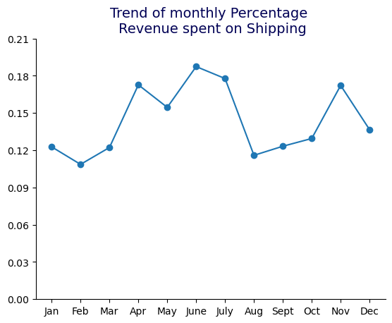
Shipping Costs Analysis
We spent a total of $27,025.12 on shipping throughout the year at an average of $2252.09 per month. This amount to 13.87% of the annual revenue at average monthly revenue of 14.36% spent on shipping

Slide 15
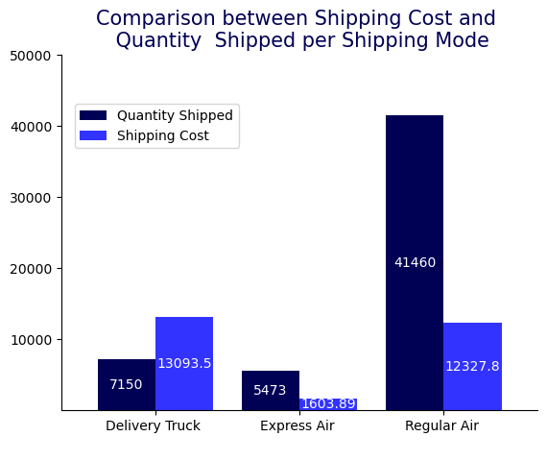
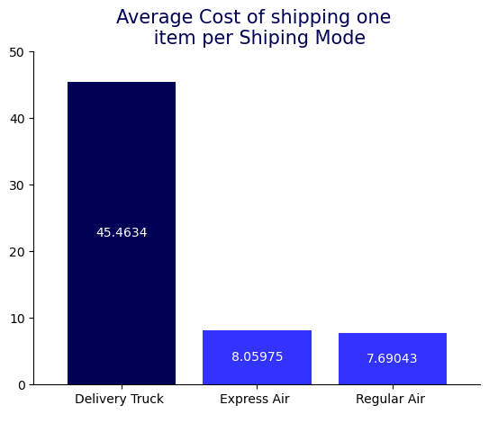
Shipping Mode Costs Analysis
We are losing a lot of opportunities on Delivery Truck mode as it costs outrageously higher a whooping 82% higher than Express Air which is the next most expensive Shipping Mode due to cost of maintaining the Fleet of Delivery Trucks
Opportunity: Contract Out Delivery Truck Mode for lesser the average cost

Slide 16
Key Takeaways and Recommendations
What Worked
Online Sales Promotion
Reduction of air shippment cost due to renegotiation of contract with Partner Airline
Areas of Opportunities
Cost of Delivery Truck Shipping mode
Out of cost of key products at peak sales period
Recommendations
Give priority to High and Critical priority orders to improve revenue from Express Fee
Hire an assistant for the Inventory Manager
Unbundle the Fleet Department and contract out Delivery Truck shipping mode
Create personalized blue chip experience for top 5 customers

